Slide 1
Rhetorical analysis

Slide 2
Our rhetorical journey
Today, we focus on rhetorical analysis and comparative rhetorical analysis
Your midterm is a comparative rhetorical analysis essay.
Rhetorical Appeals
Rhetorical Analysis
Comparative Rhetorical Analysis

Slide 3
Overview
Rhetorical Analysis: What is it and how do I do it?
Comparative Rhetorical Analysis

Slide 4
Rhetorical Analysis – What is it?
Identifies the rhetorical techniques used by a writer and evaluates how effective they are in persuading the target audience

Slide 5
How do I perform a rhetorical analysis?
Understand the rhetorical situation
Identify the rhetorical strategy with evidence
Evaluate if this strategy is effective on the target audience
This is not about your reaction – keep focused on the target audience.

Slide 6
Rhetorical Analysis does not
Engage in a critique of the author or their position
Engage in the issue being discussed
Does not agree or disagree with the author’s argument
Again, this is not about you – focus on if the argument is persuasive for the target audience.

Slide 7
Perform a rhetorical analysis
In the same groups as last class and using the same image, determine the following:
Rhetorical situation (who is talking to whom about what)
Rhetorical strategy (how is the speaker attempting to convince the audience)
If the strategy is effective on the target audience
Each group will then present their findings to the class (2-5 minutes per presentation).

Slide 8





1
3
2
5
4

Slide 9
Exercise: Practice Rhetorical Analysis
Optional discussion post
A chance to practice your rhetorical analysis skills BEFORE the CRA essay AND get feedback!
Remember to use academic writing conventions (tone, revision) in your post.

Slide 10
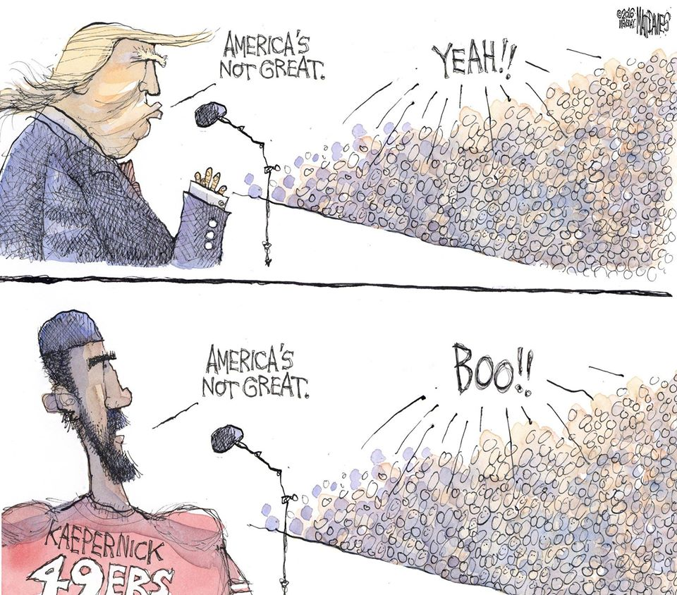
Comparative Rhetorical Analysis
Comparing two things (texts/ads) can lead to additional insights

Slide 11
Comparative Rhetorical Analysis
Comparing how two different texts use rhetorical strategies differently to convey their messages to their respective target audiences
Adds another level of complexity to your analysis
Requires you to clarify your purpose in comparing the two articles
Requires you to choose the two articles carefully so that you have a meaningful reason to compare them.

Slide 12
Before you being a CRA
Ensure the texts chosen have a compelling reason to be compared. For example
both texts have a similar audience and message/content, but one uses logos and the other uses pathos
both texts have a similar message/content, but have different audiences and used different rhetorical appeals

Slide 13
When will you use this?
Your midterm is a comparative rhetorical analysis, written over 2 classes.

Slide 14
How to perform a CRA
Identify the rhetorical situation of both texts
Identify the rhetorical strategies being used in both texts
Identify the similarities and differences for comparison
So let’s practice!

Slide 15


Slide 16


Slide 17
Video CRA
In groups, perform a CRA of these two videos. Fill out the following comparison table to organize your thoughts.
You can find these videos in Module 5.

Slide 18
 | Similarities | Differences
Audience
Rhetor
Message
Rhetorical Strategies

Slide 19
Recap
Rhetorical Appeals: Logos, ethos, pathos, and kairos are persuasion techniques
Rhetorical Analysis: Rhetorical situation + rhetorical appeals + evaluation
Comparative Rhetorical Analysis: Rhetorical analysis x2 + evaluative comparison

Slide 20
Next week
Preparing for the upcoming CRA Essay:
Thesis Statement workshop
CRA Worksheets

Slide 21
Further reading

